Slide 1


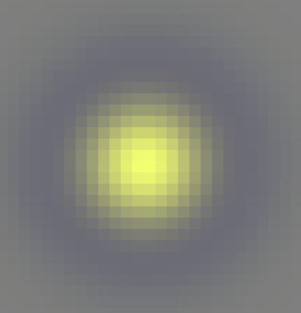
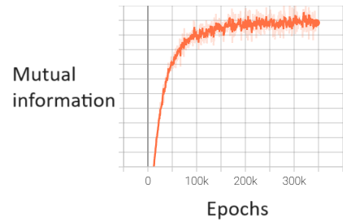
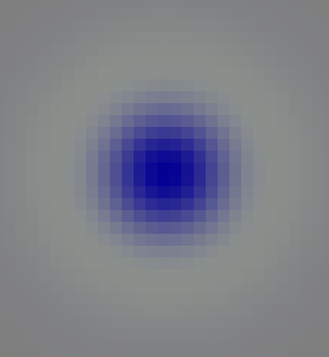
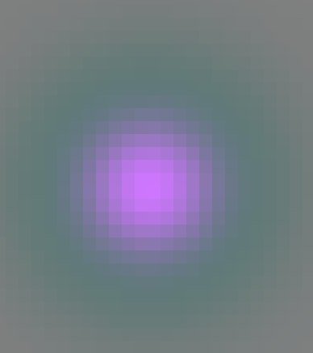
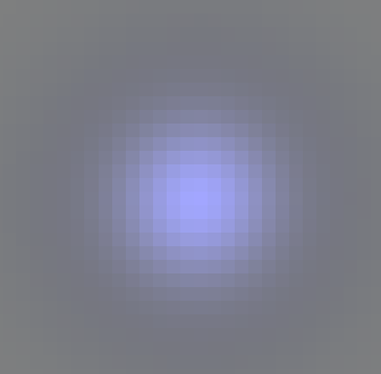
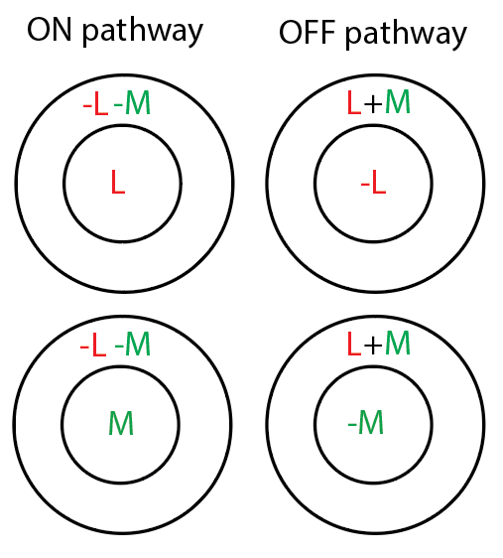
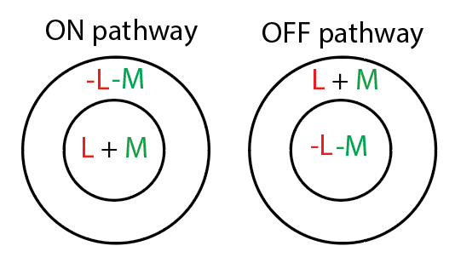
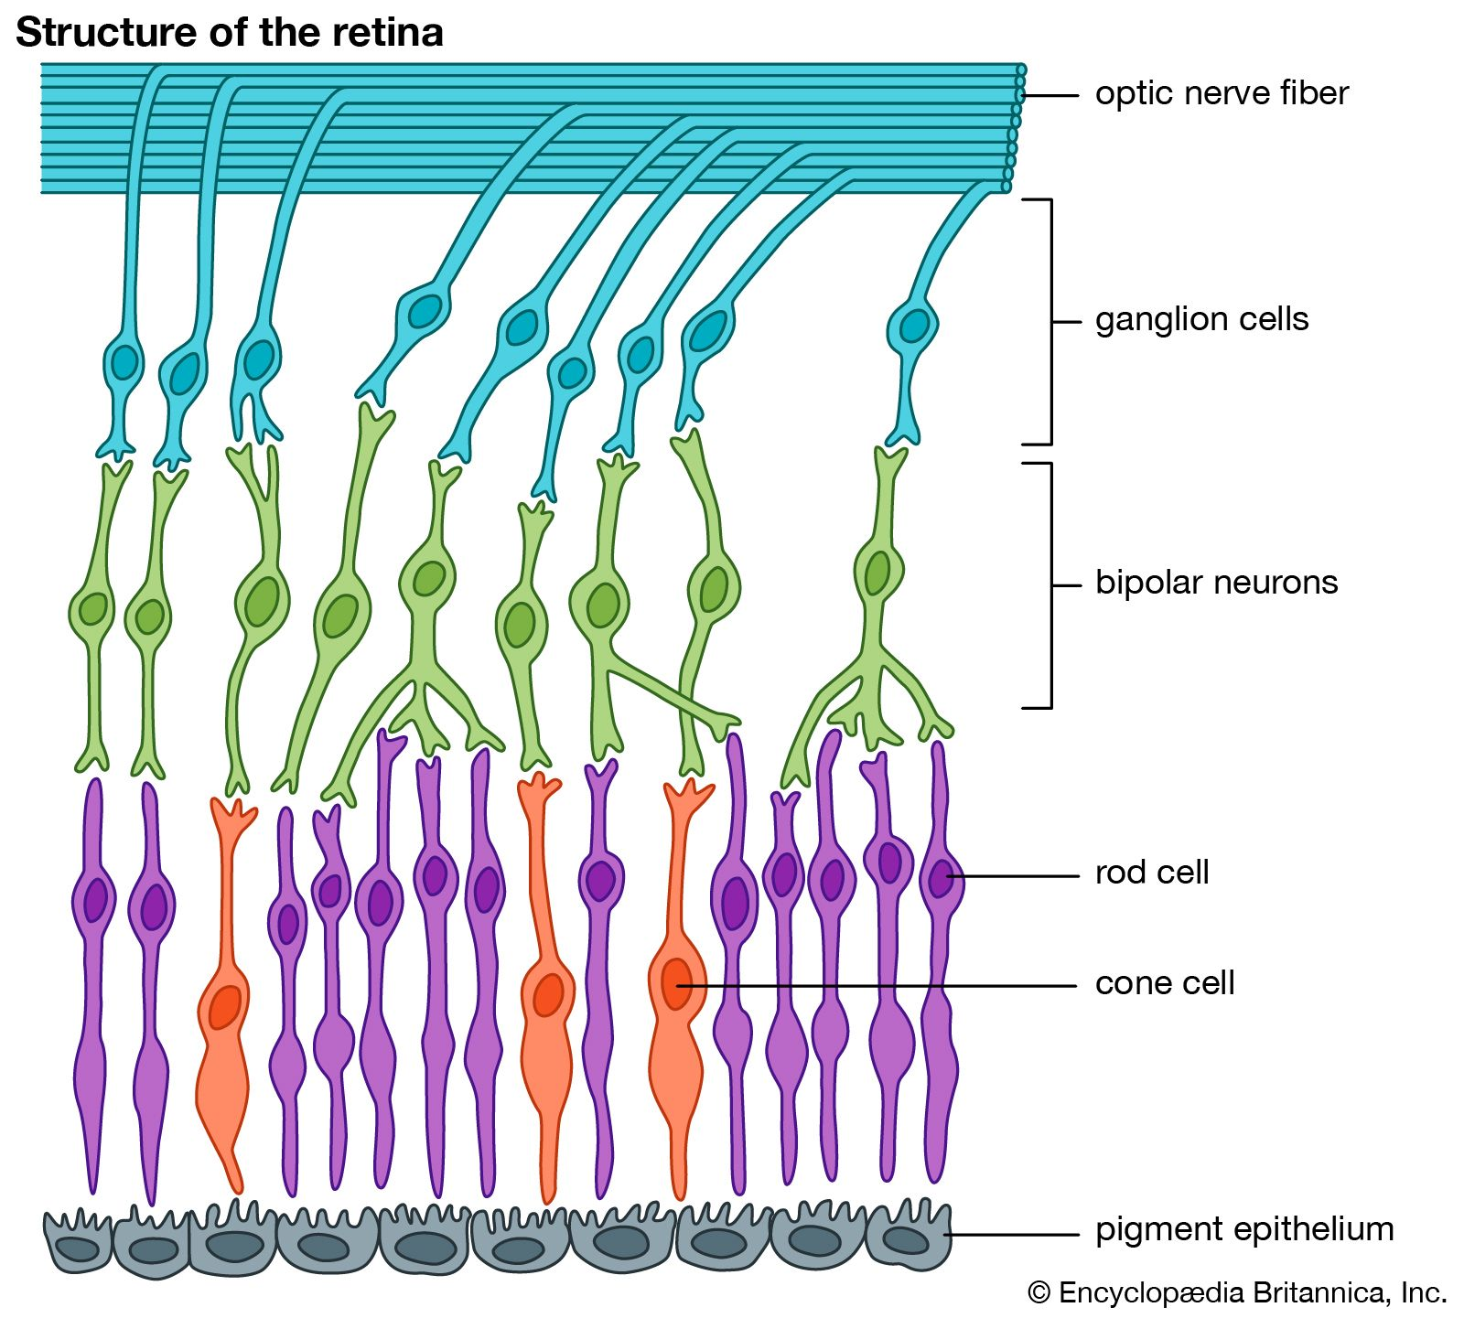
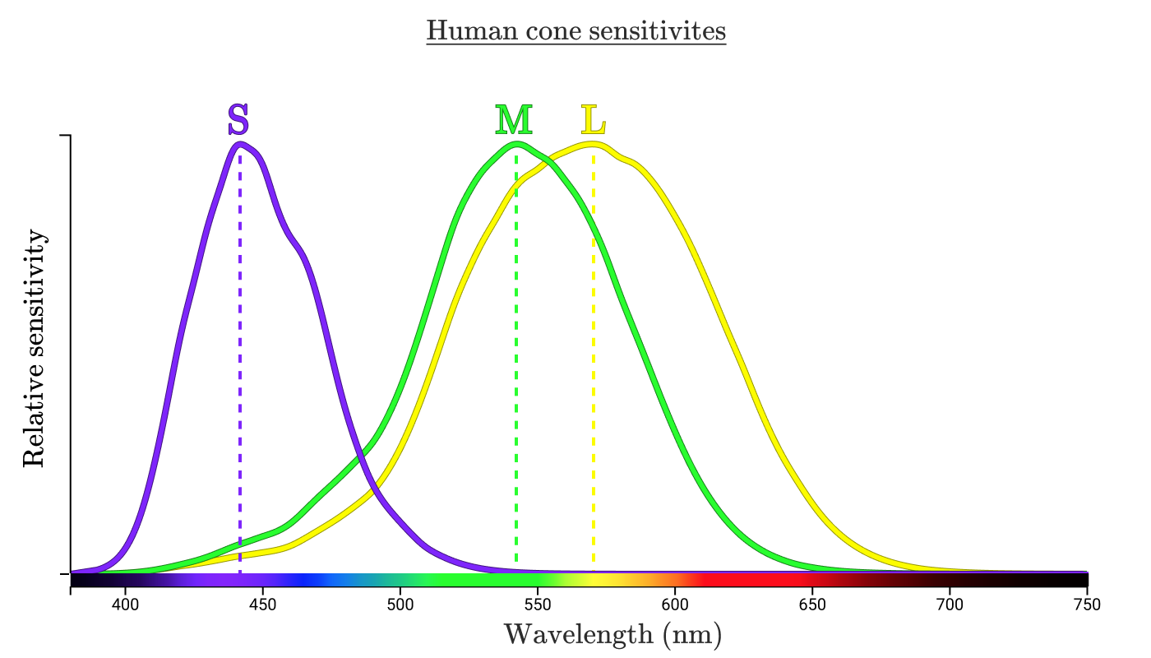
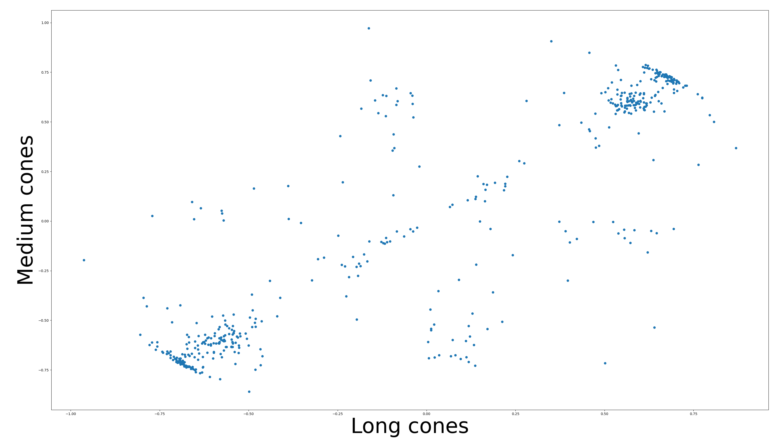
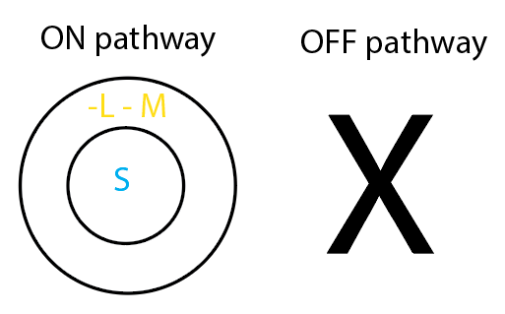
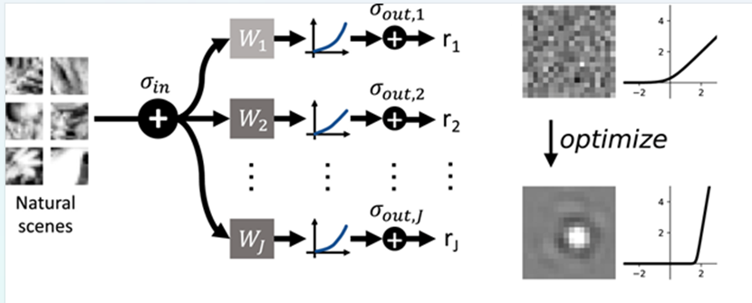
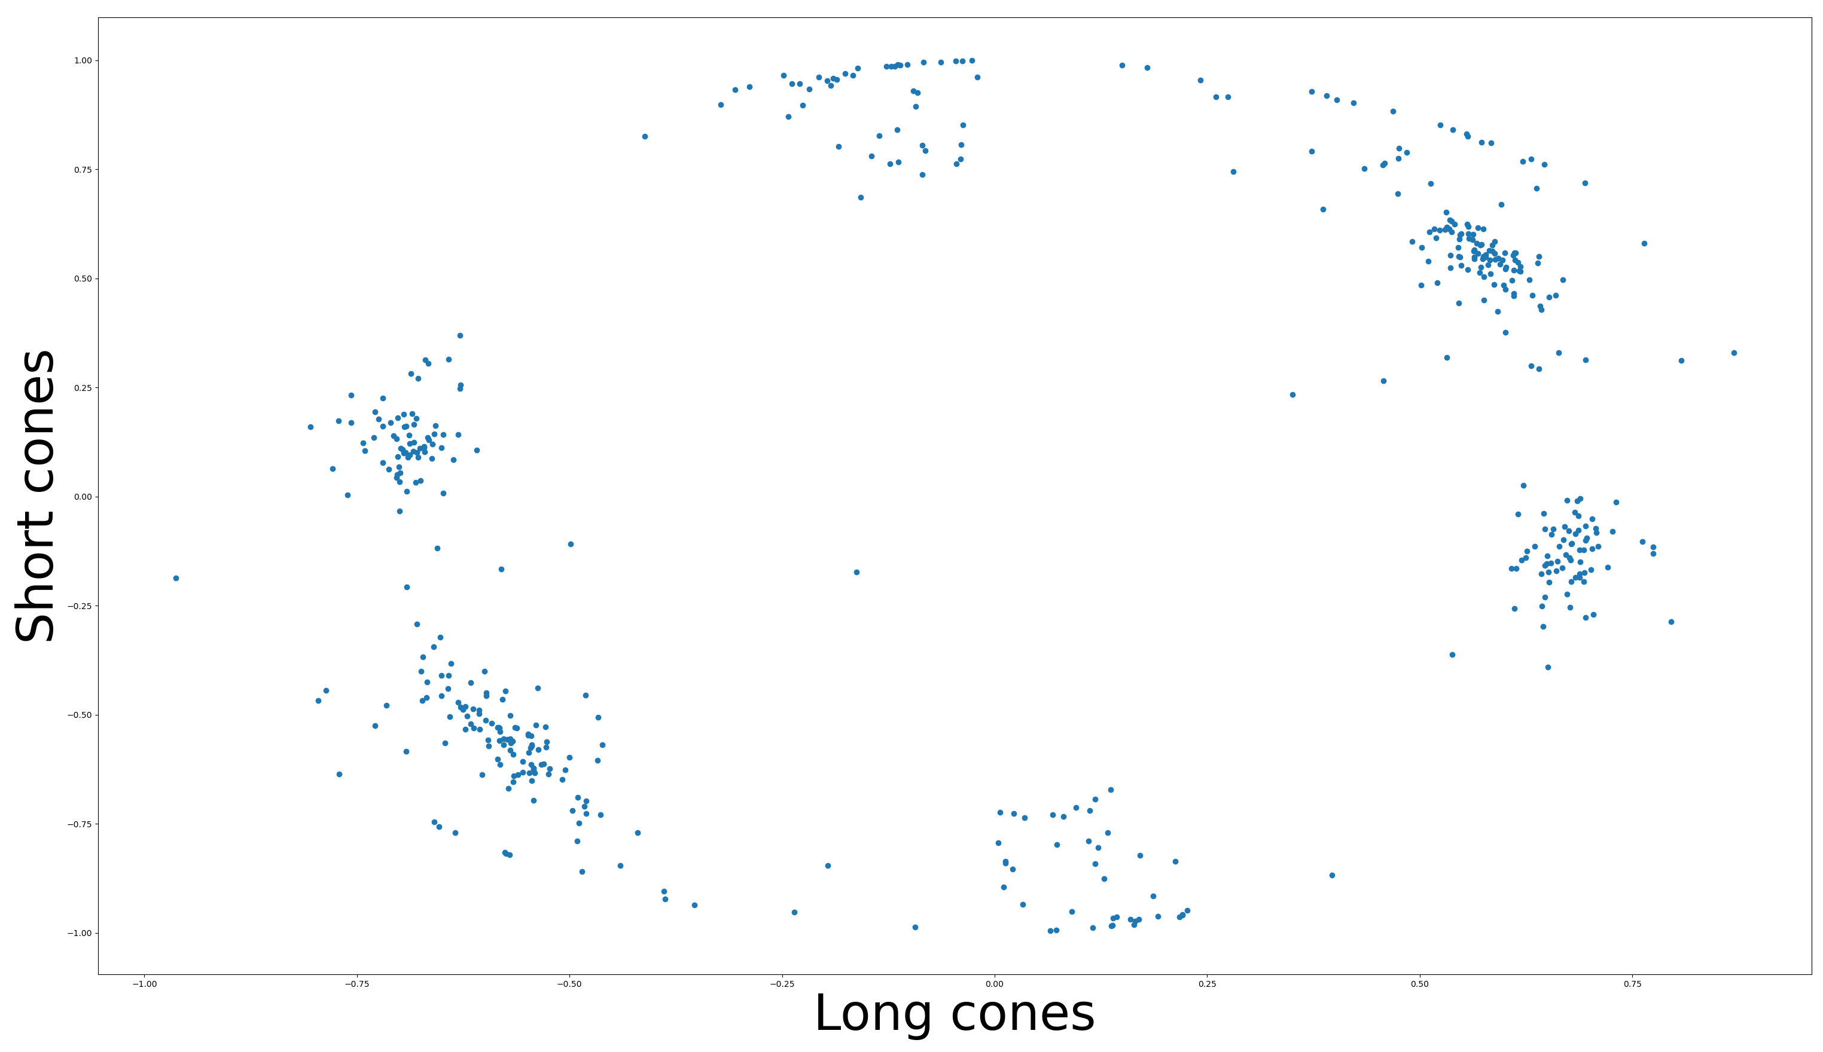
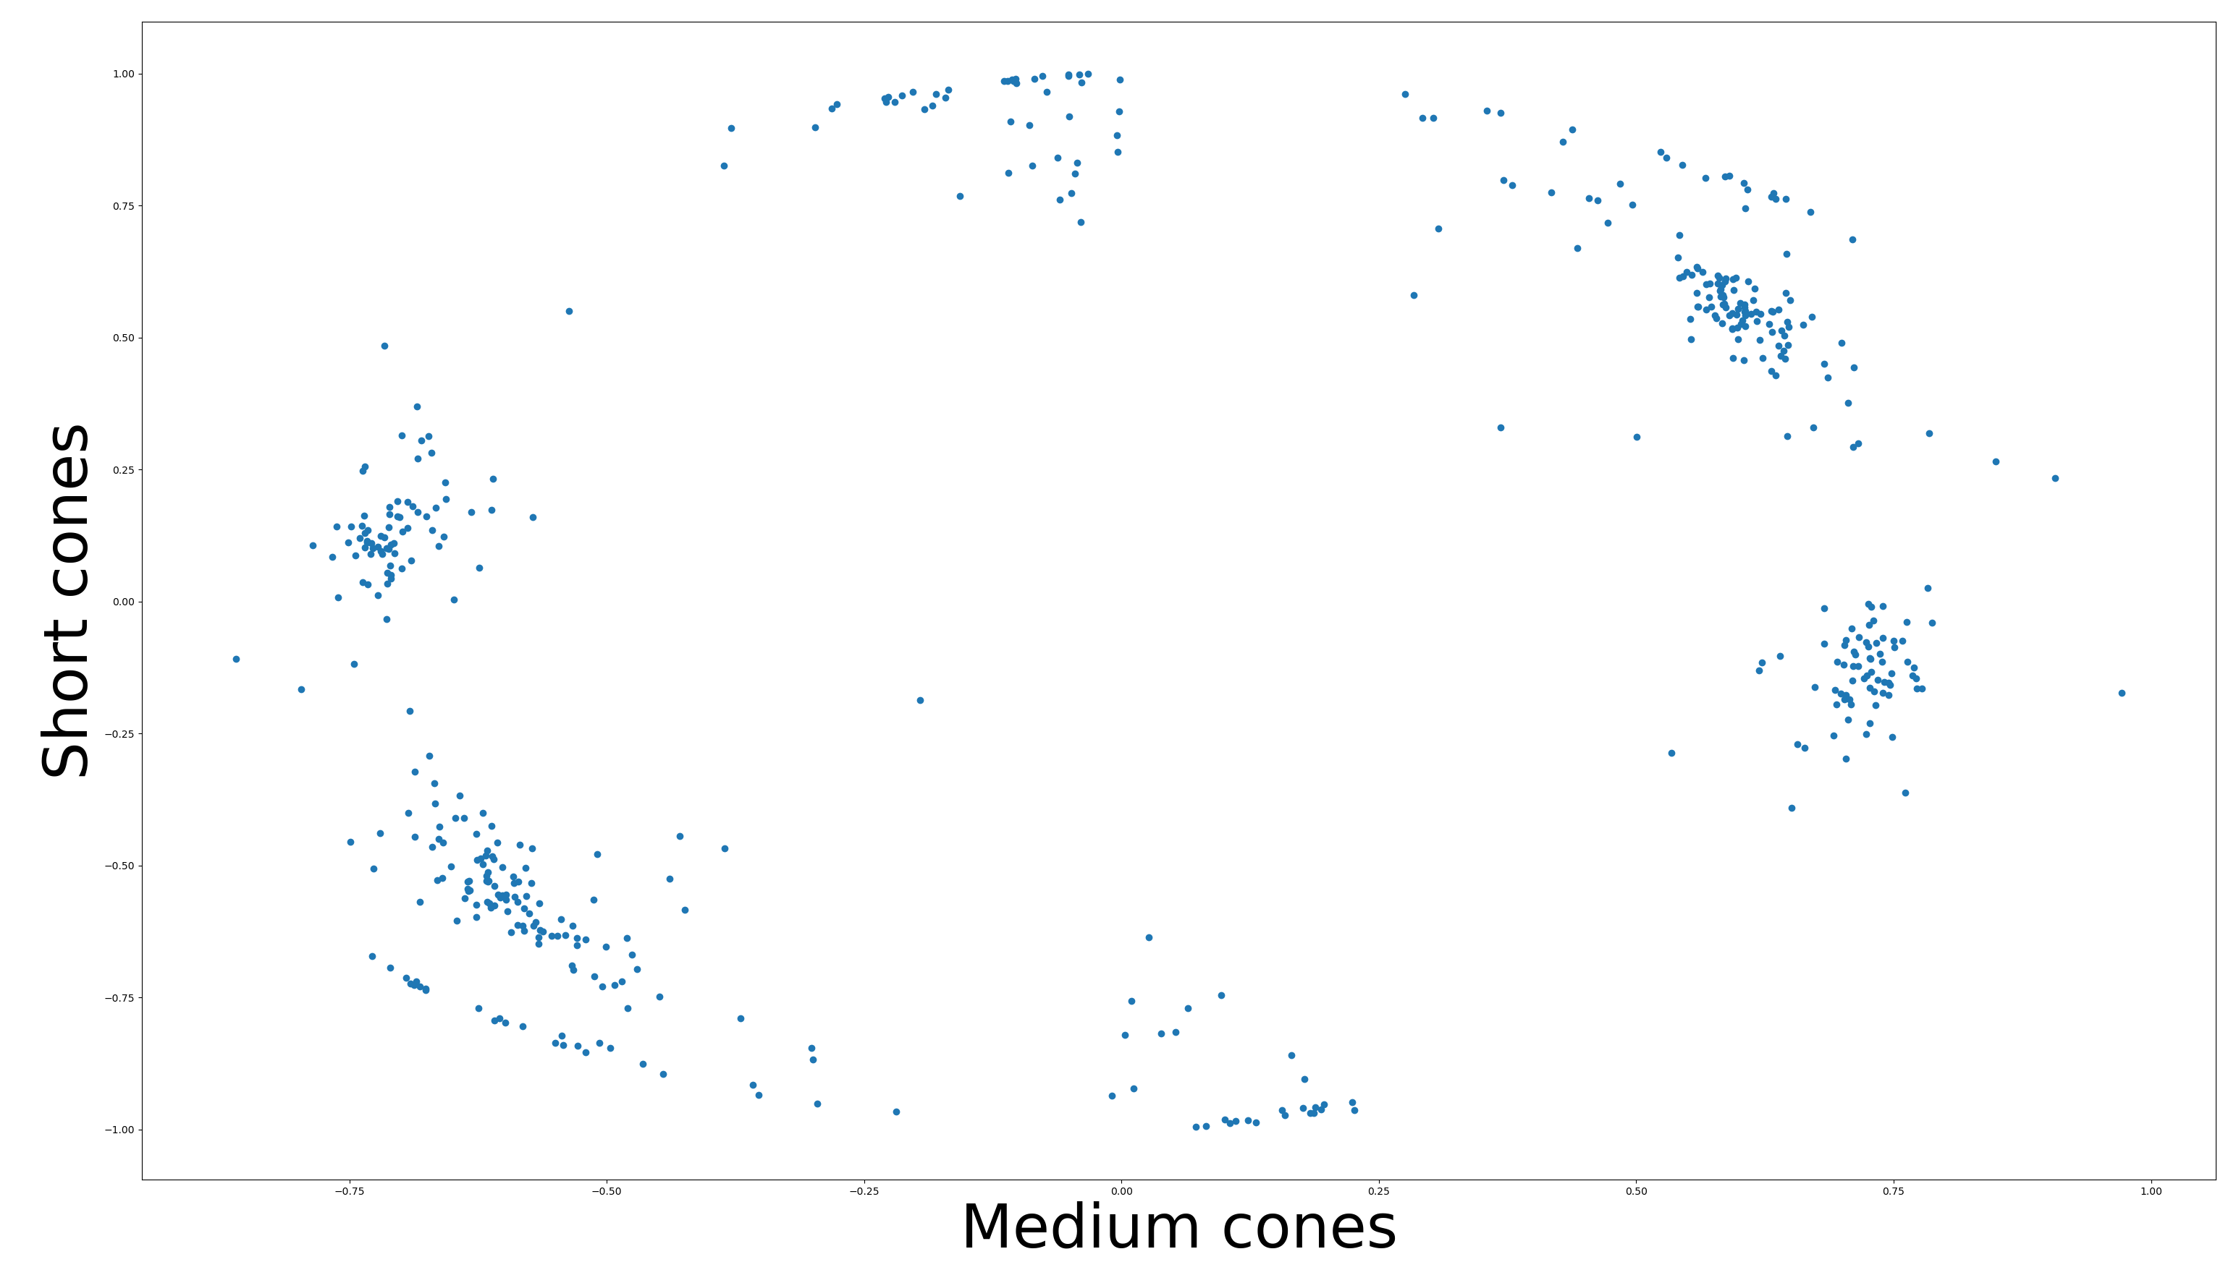
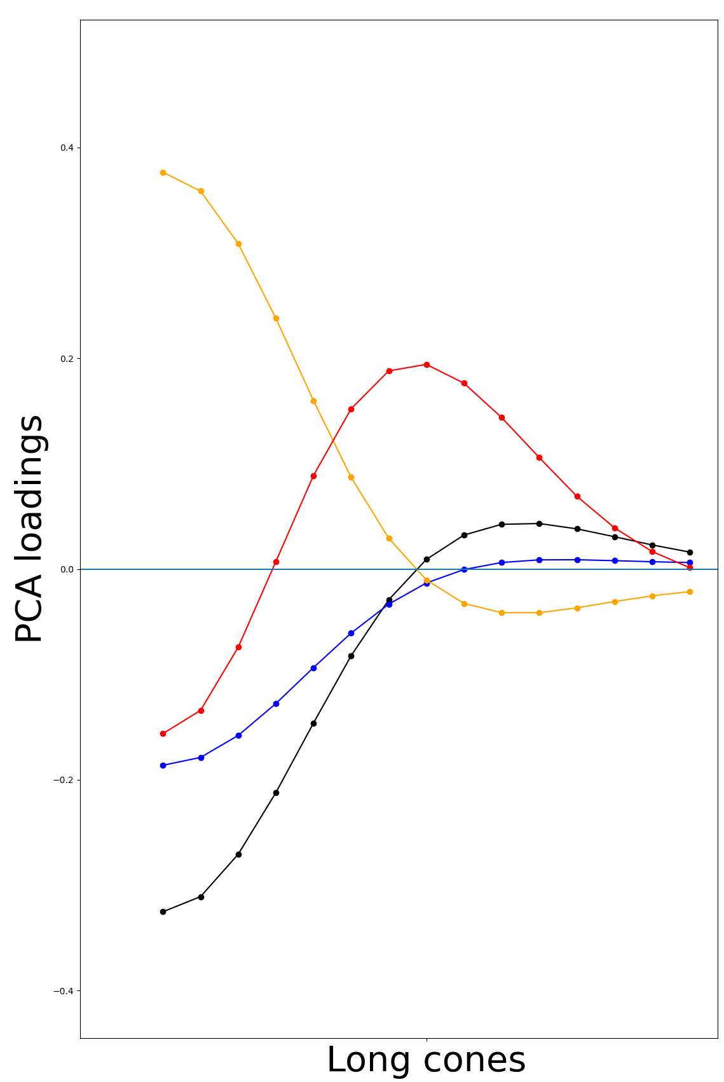
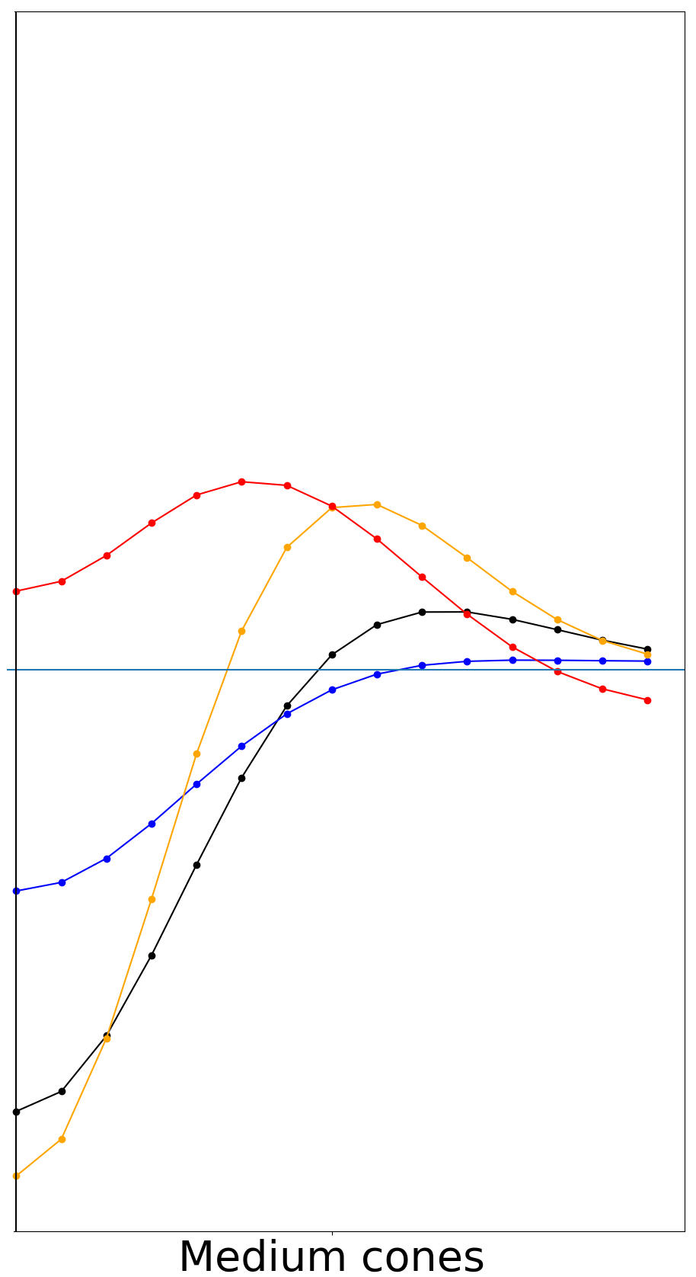
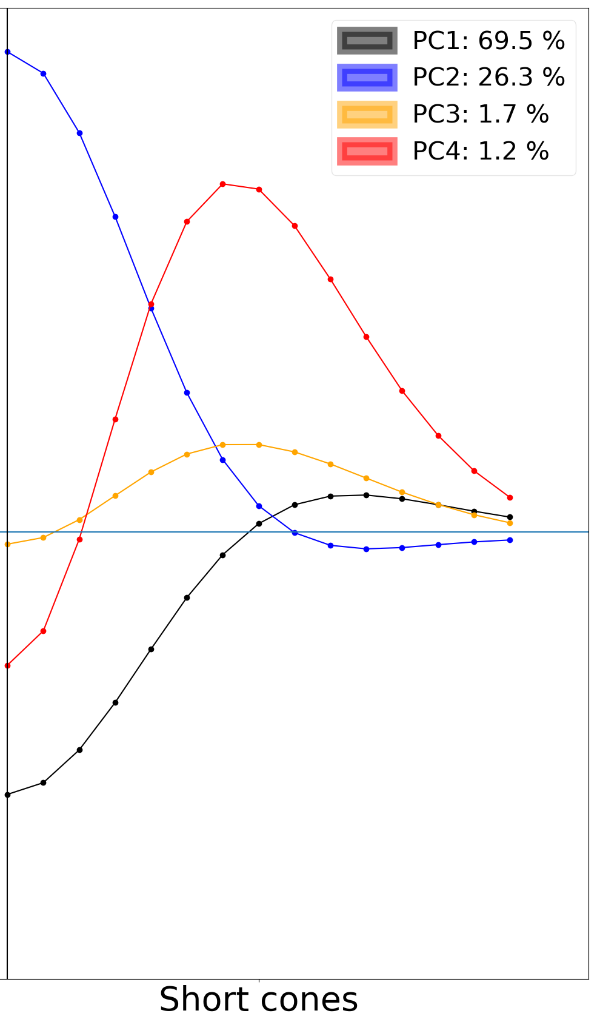
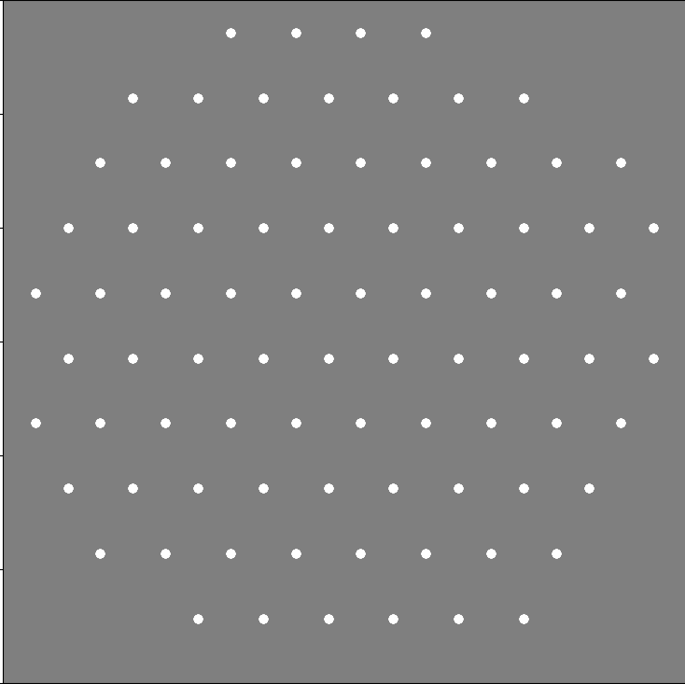
How to efficiently encode chromatic natural images in the retina
David St-Amand, Greg Field and John Pearson
Pearson Lab, Neurobiology Department, Duke University, Durham, NC, USA
Introduction
Results
Discussion
Efficient coding: Sensory systems should efficiently encode their inputs (Barlow, 1961)
Efficient coding models have been especially successful at explaining how populations of neurons should encode achromatic natural images (Karklin & Simoncelli, 2011; Jun et al., 2021)
Many neurons in the retina (especially in the fovea) encode the difference between Long, Medium and Short cones. This color-opponency strategy has previously been shown to be efficient (Buchsbaum & Gottschalk, 1983; Atick & Redlich, 1992). However, how a population of retinal ganglion cells should encode different color-opponent signals is less well understood.
Model neurons have both chromatic and achromatic center-surround receptive fields
Mutual information converges after about ~200k epochs
Previous experiments have shown that:
80% of retinal ganglion cells (RGCs) are midget cells (red-green)
10% of RGCs are bistratified ganglion cells (blue-yellow)
10% of RGCs are parasol cells (black-white)
In the fovea, midget cells are red-green opponent
In the periphery, midget cells are not red-green opponent and instead sum both L and M cone inputs
Midget cells in Fovea
Midget cells in Periphery
Very strong correlation between L and M cone inputs (r = 0.88)
Bistratified ganglion cells
Efficient coding model:
S inputs are mildly correlated with L and M inputs (r = 0.36 and 0.4)
Therefore, our findings:
Explain why midget cells in the periphery, but not in the fovea, are efficient
Suggest that achromatic receptive fields might encode more information than chromatic receptive fields
References
PCA shows that most of the variance in receptive fields is achromatic
Atick, J. J., Li, Z., & Redlich, A. N. (1992). Understanding retinal color coding from first principles. Neural computation, 4(4), 559-572.
Barlow, H. B. (1961). Possible principles underlying the transformation of sensory messages. Sensory communication, 1(01), 217-233.
Buchsbaum, G., & Gottschalk, A. (1983). Trichromacy, opponent colours coding and optimum colour information transmission in the retina. Proceedings of the Royal society of London. Series B. Biological sciences, 220(1218), 89-113.
Jun, N. Y., Field, G. D., & Pearson, J. (2021). Scene statistics and noise determine the relative arrangement of receptive field mosaics. Proceedings of the National Academy of Sciences, 118(39), e2105115118.
Karklin, Y., & Simoncelli, E. (2011). Efficient coding of natural images with a population of noisy linear-nonlinear neurons. Advances in neural information processing systems, 24.
Training objective:
The weights are drawn from parametrized Difference of Gaussian:
Receptive field centers were fixed to form six different mosaics with same centers:
We trained the model to efficiently encode natural images (12x12x3) from the Kyoto Natural Images Dataset in 498 different neurons
Distance from RF center (pixels)

